Slide 4
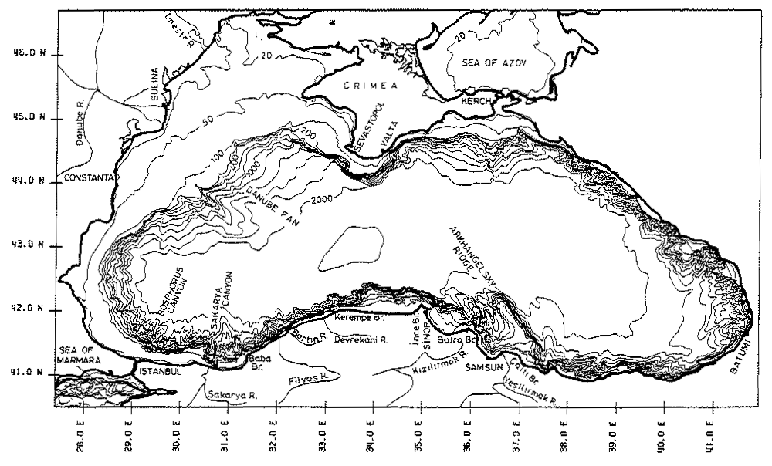

Slide 5
Anoxic basin - 87 % of total volume
eutrophication and ecosystem deterioration
deep water residence time:
(based on isotope dating, Östlund, 1974)
changes from 1 year at CIL ~100m
to ~2000 year near bottom
negligible tides (<10 cm)
K_{ρ}<10⁻⁶ m²/s below the seasonal pycnocline in the absence
of winds and tides (Gregg et al., 1999)

Slide 6
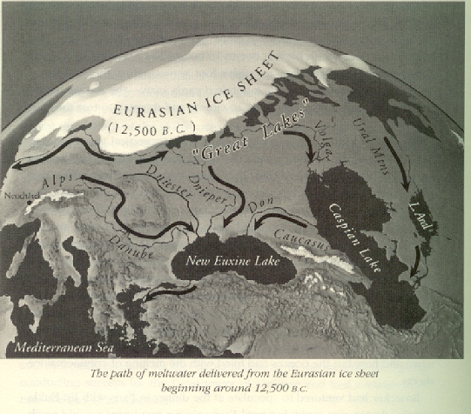
Ryan and Pitman - ‘NOAH’S FLOOD’

Slide 7
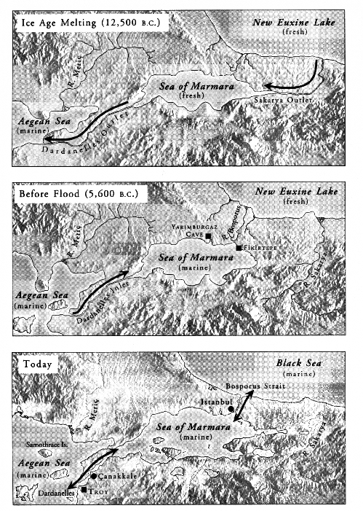

Slide 8
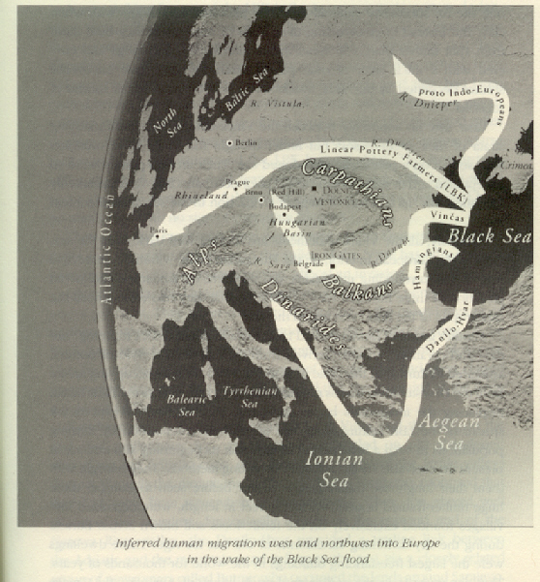
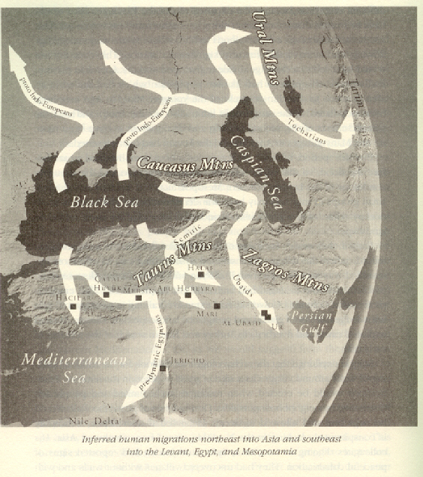
NOAH’S FLOOD ca 7500 bp

Slide 9
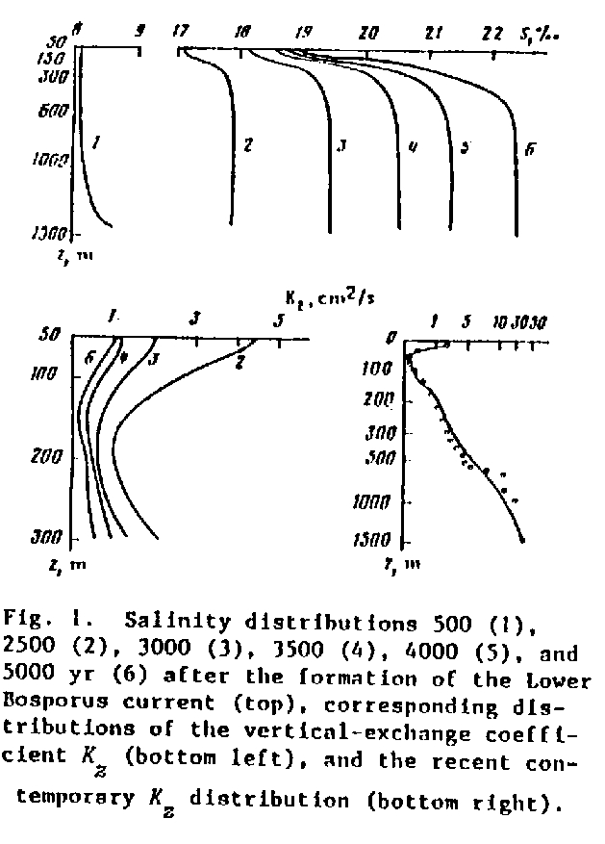

Slide 10
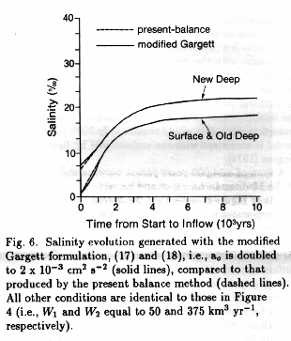

Slide 11
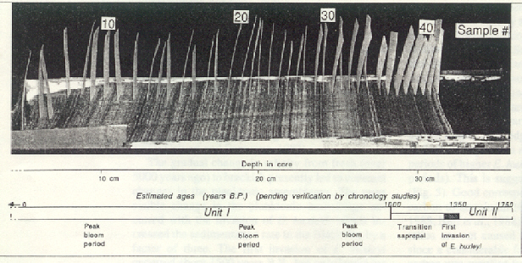

Slide 12
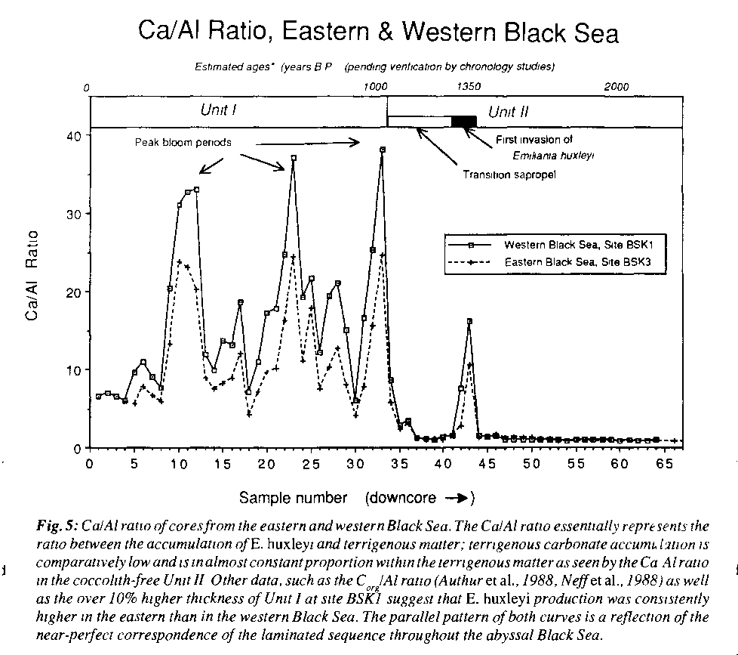

Slide 13
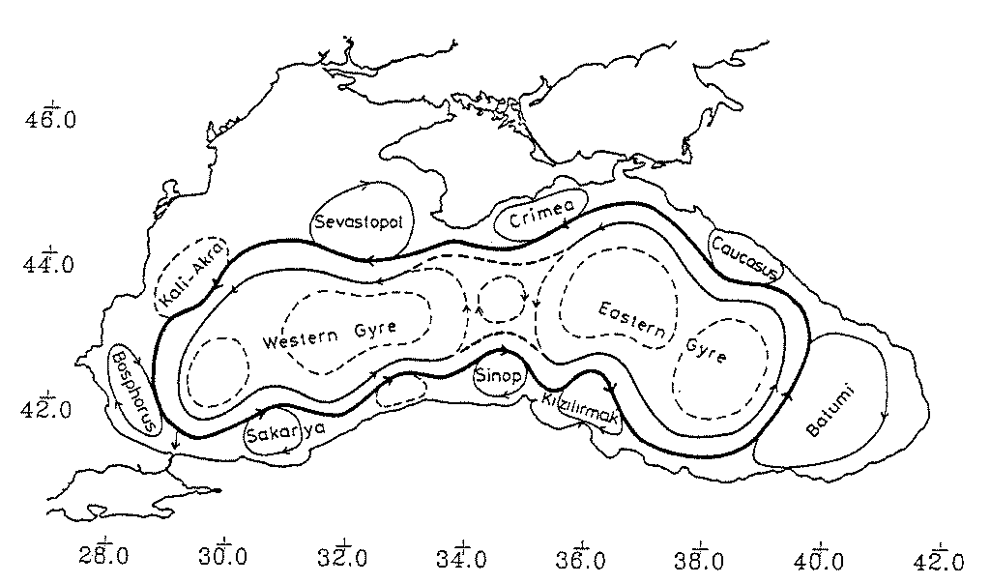
Oğuz et al., 1991

Slide 14
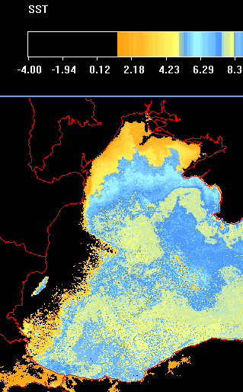
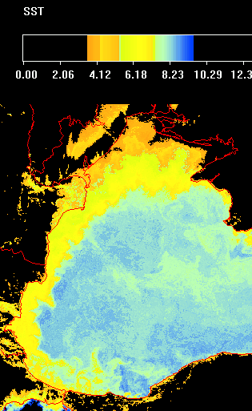

Slide 15
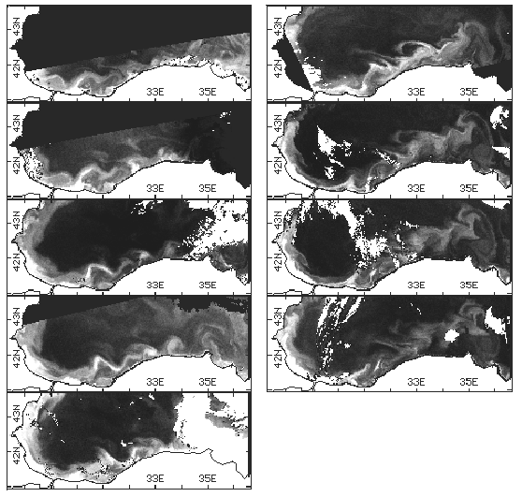

Slide 16
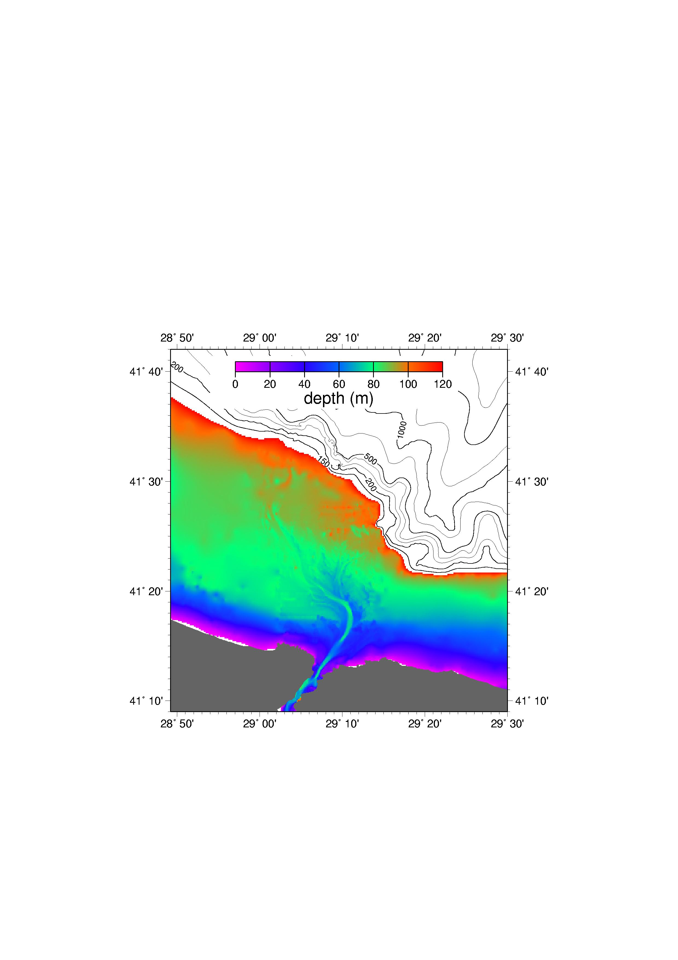

Slide 18
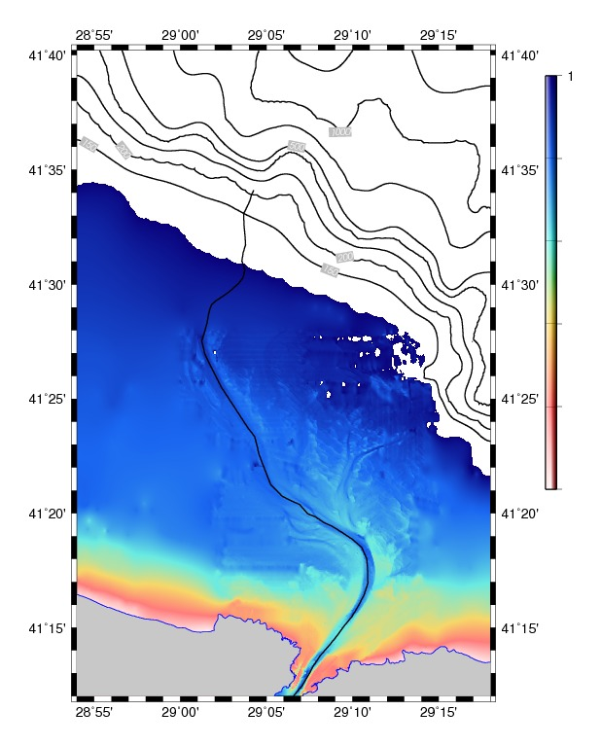

Slide 19
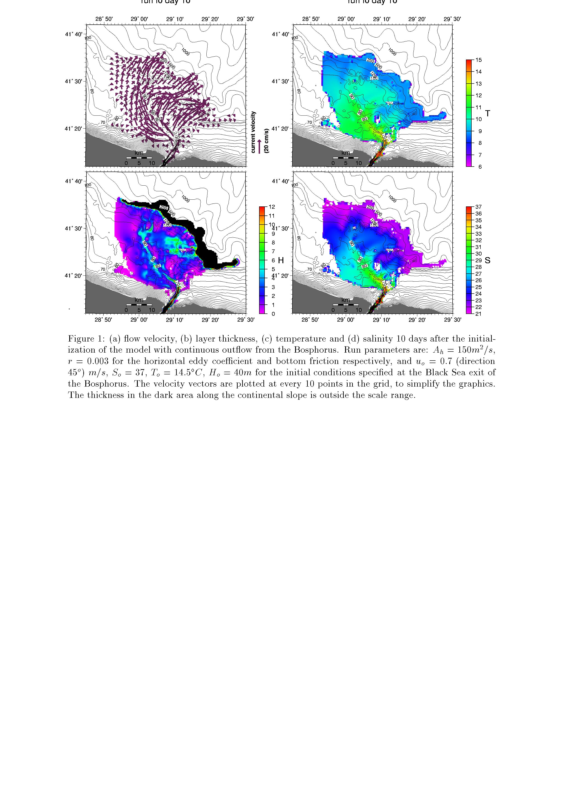
Özsoy et al., 2001

Slide 20
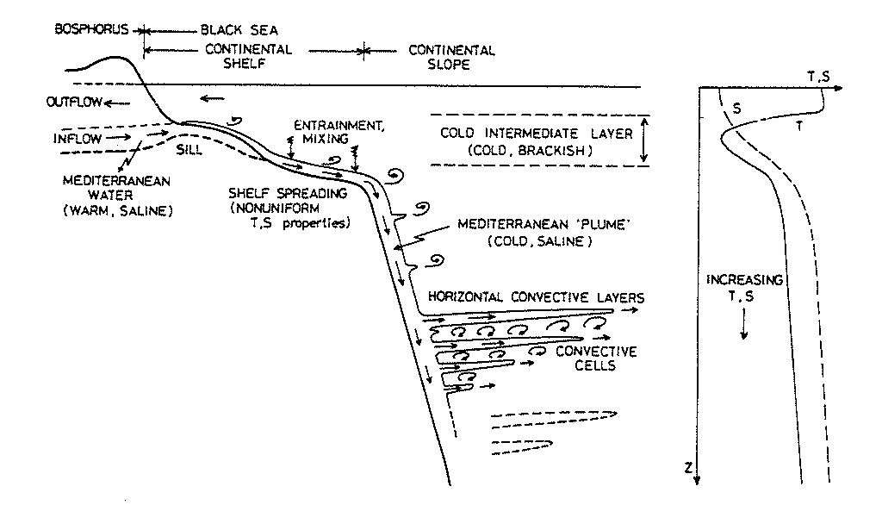

Slide 21
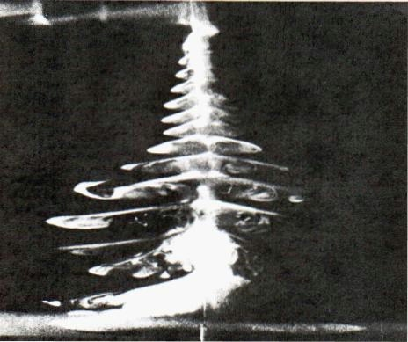

Slide 22
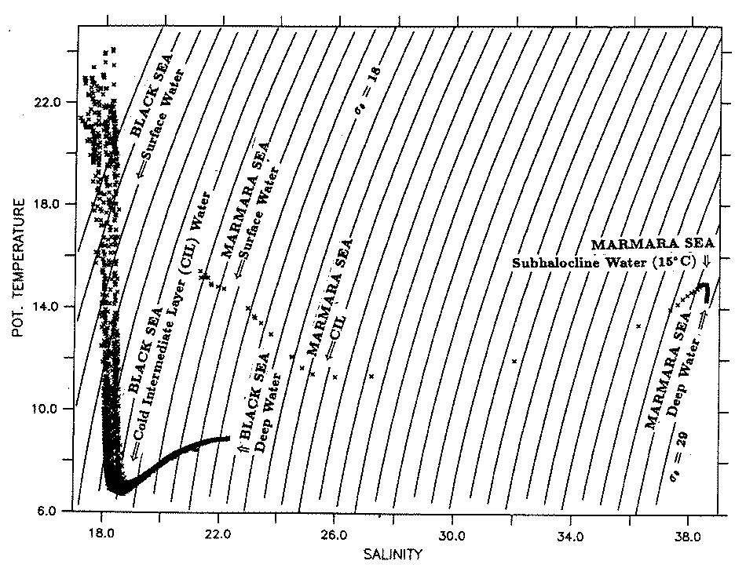
Özsoy et al., 1993

Slide 23
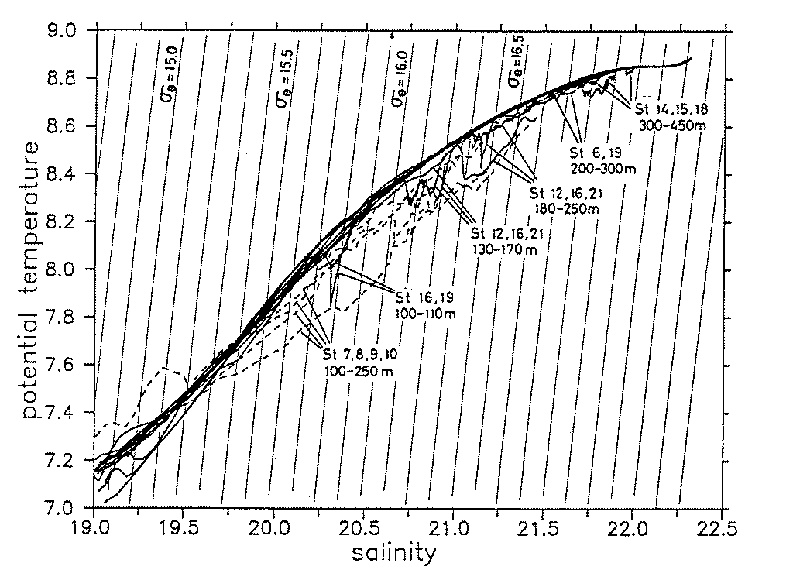

Slide 24
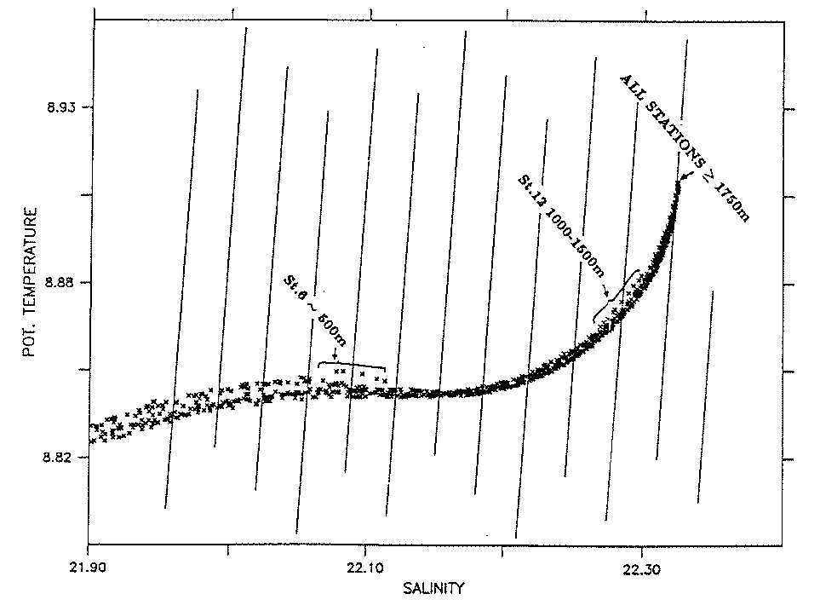

Slide 25
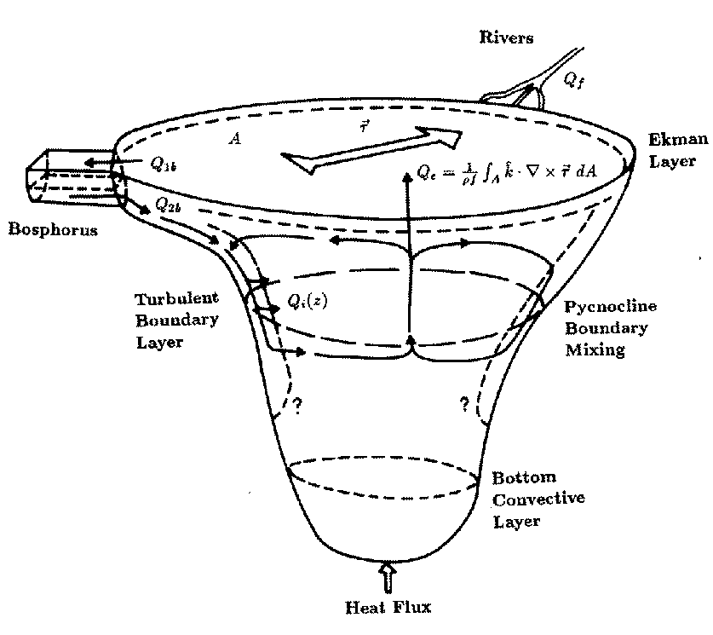
Özsoy et al., 1993

Slide 26
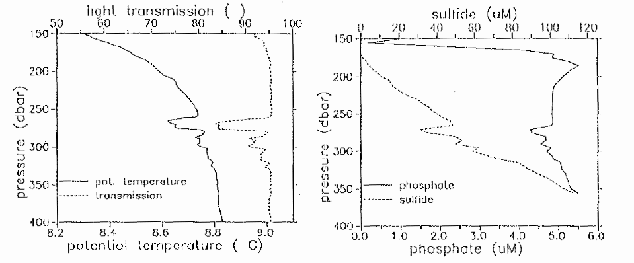

Slide 27
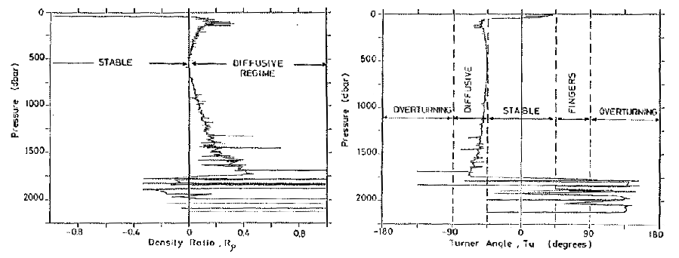

Slide 28
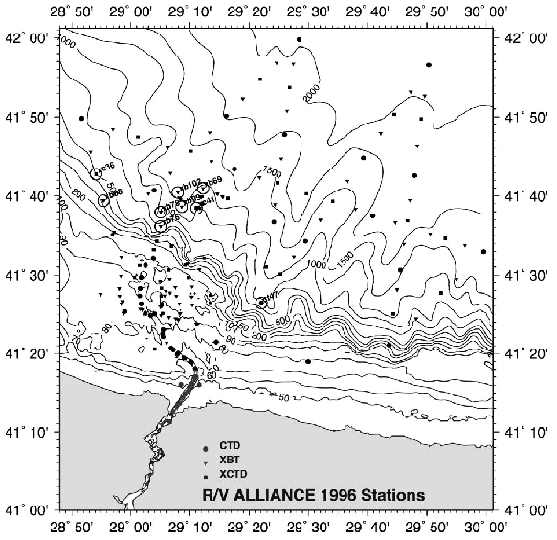

Slide 29
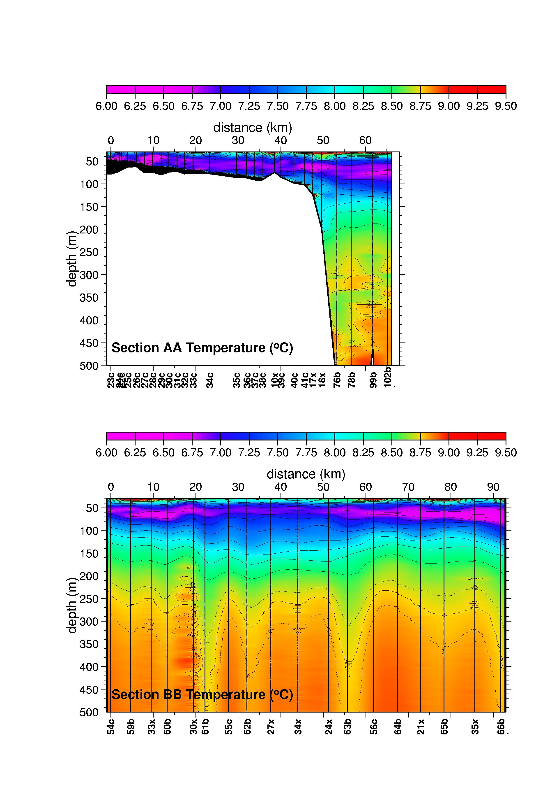

Slide 30
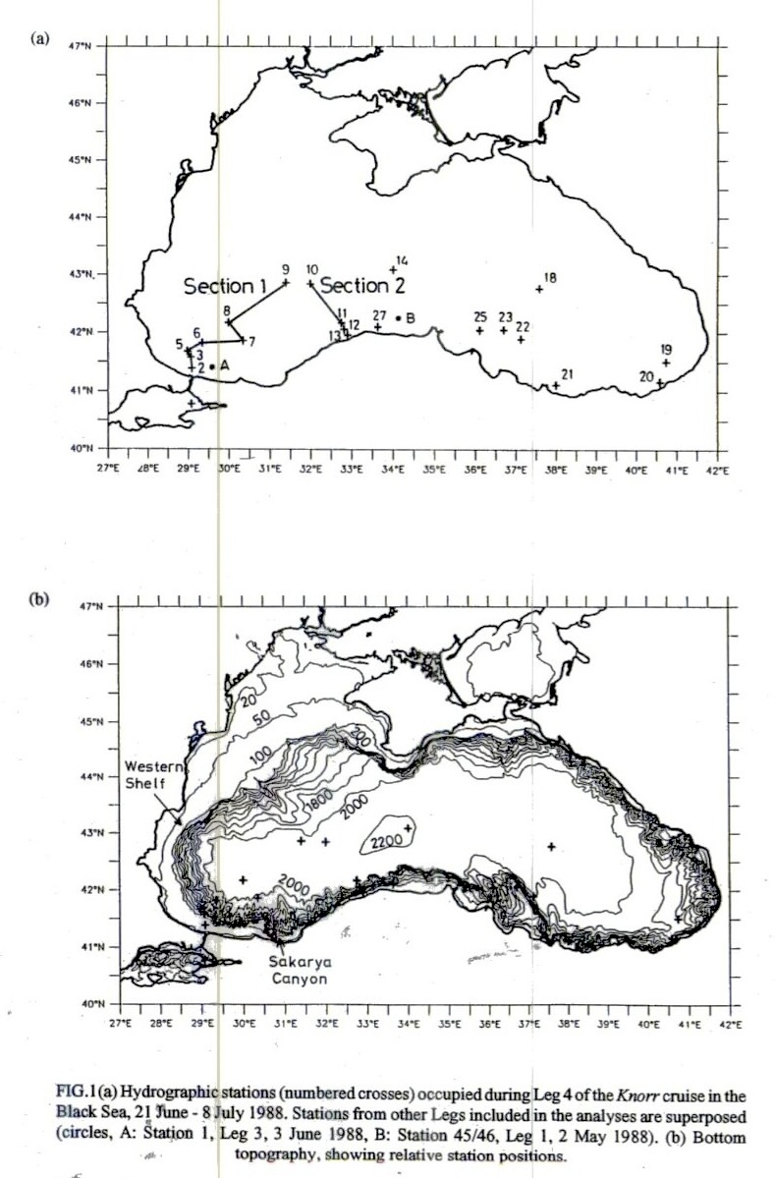
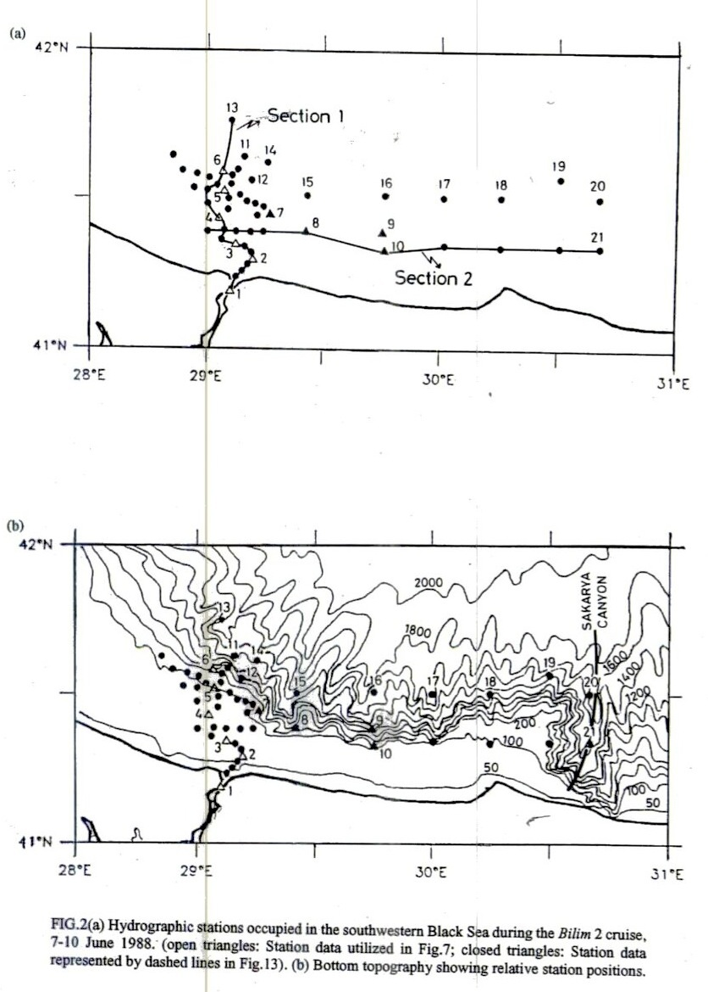

Slide 31
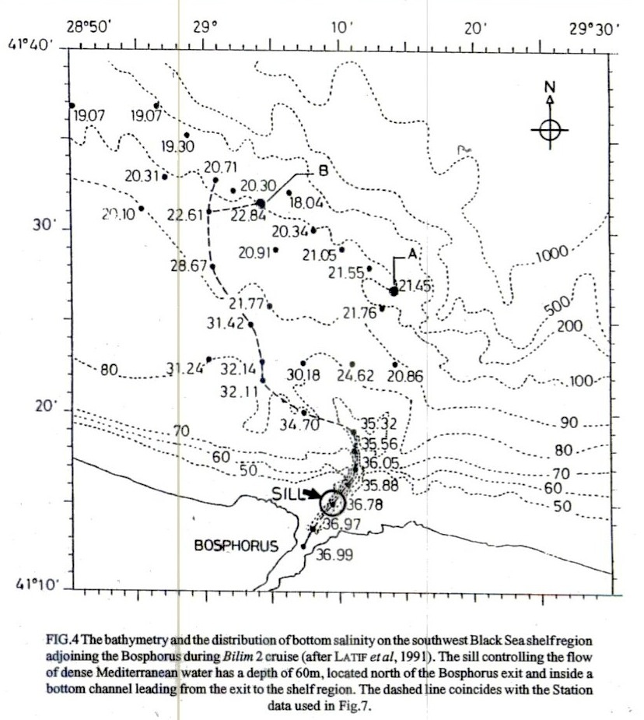
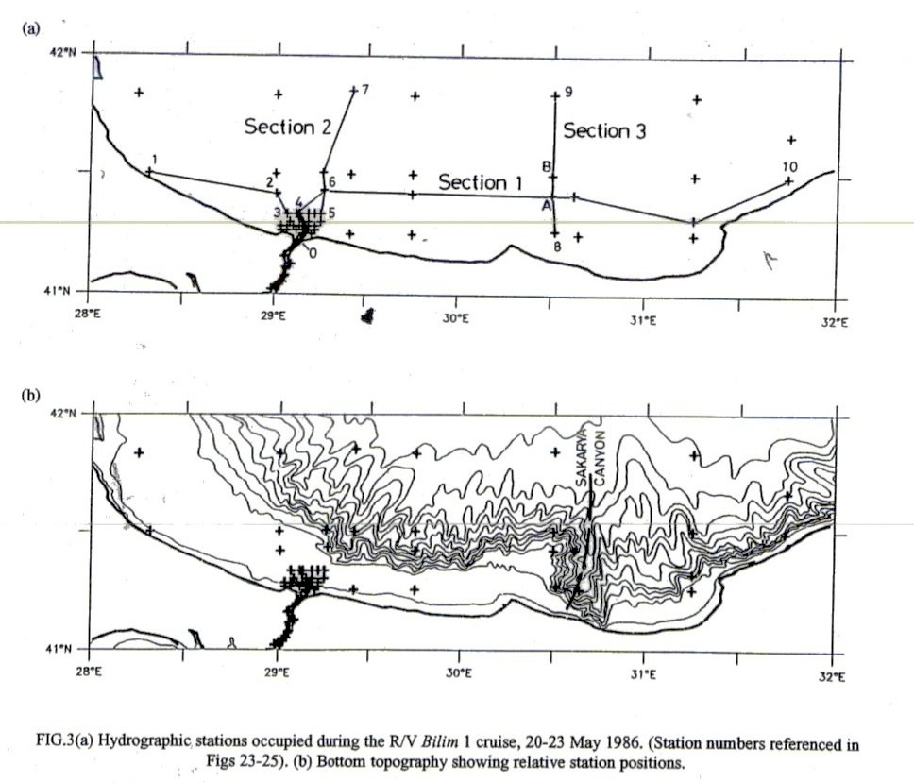

Slide 32
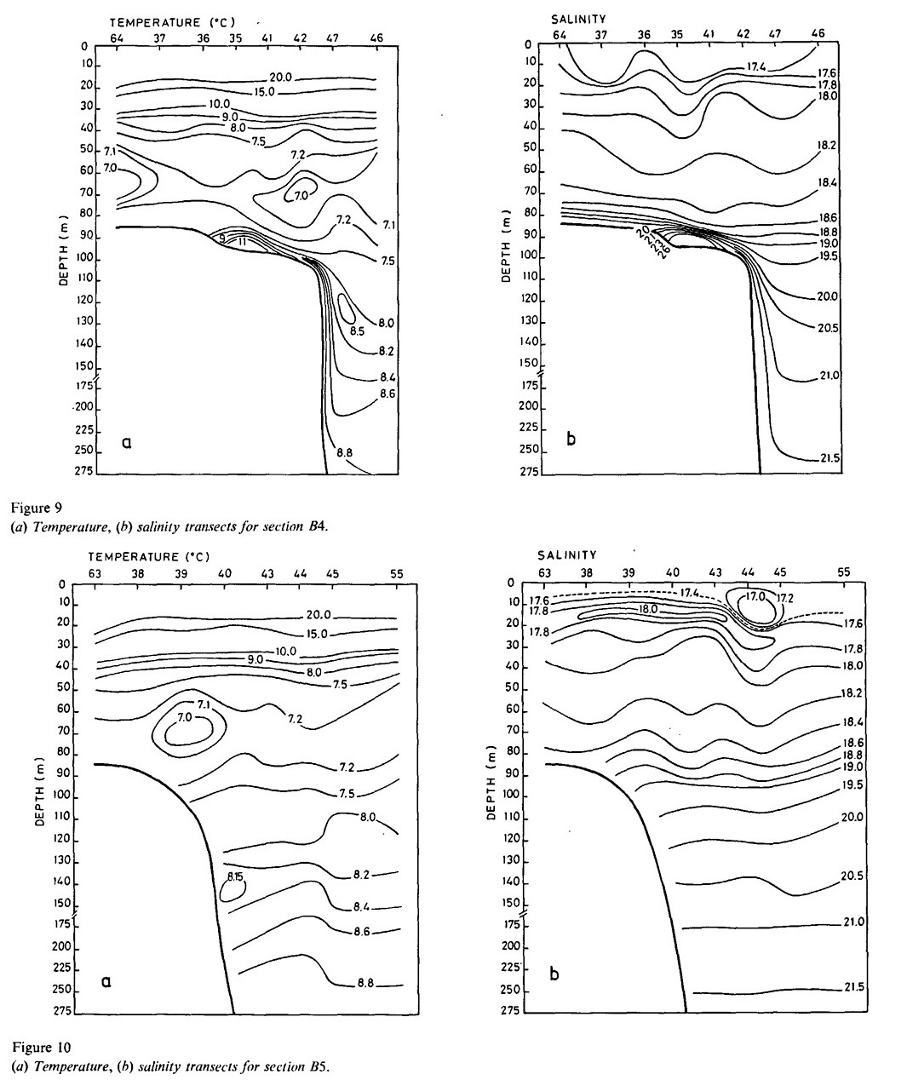
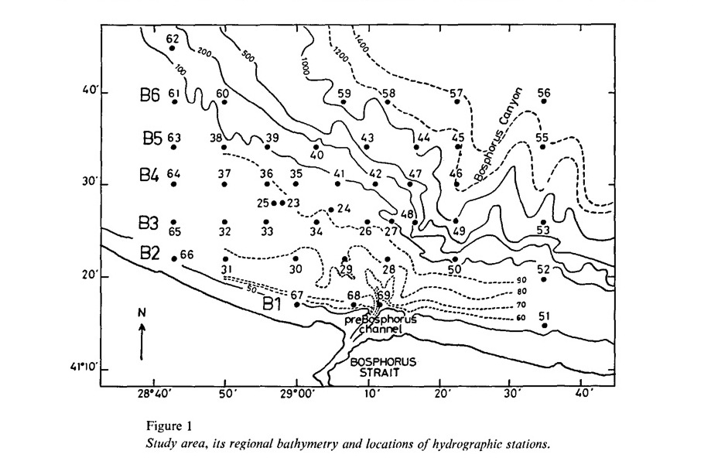
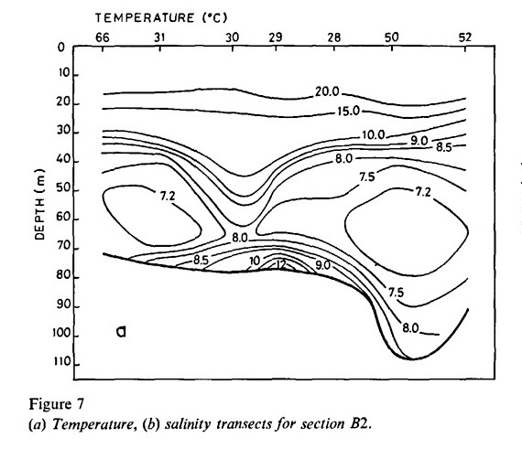
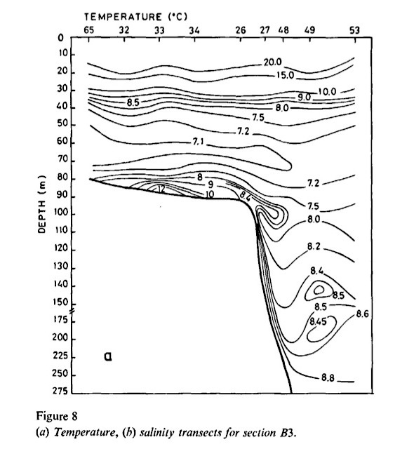
Oğuz and Rozman, 1991

Slide 33
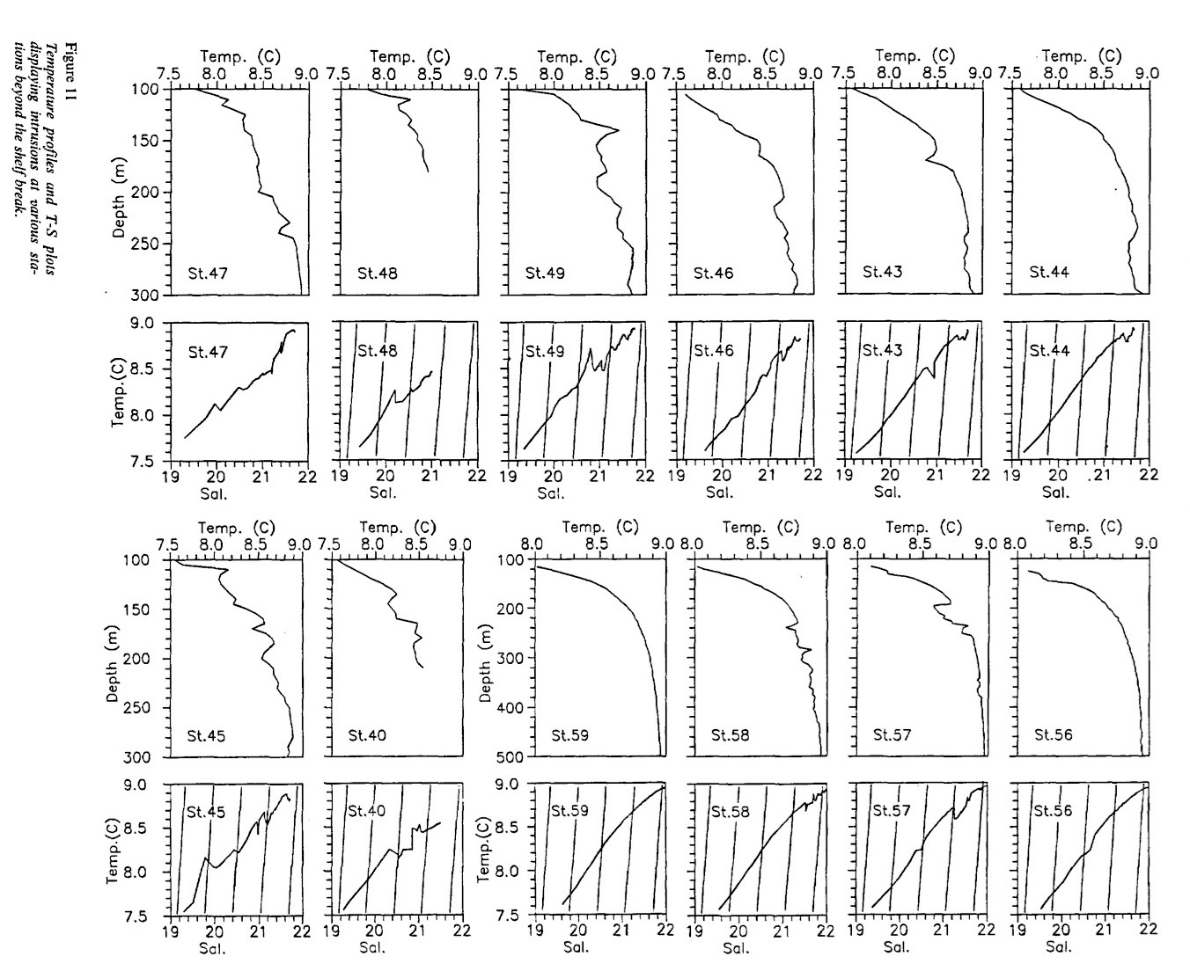

Slide 34
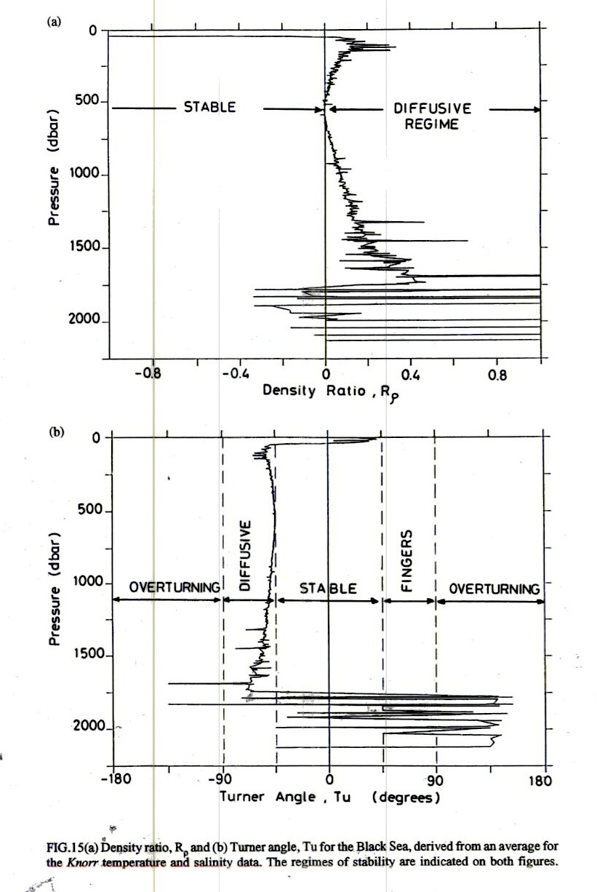

Slide 35
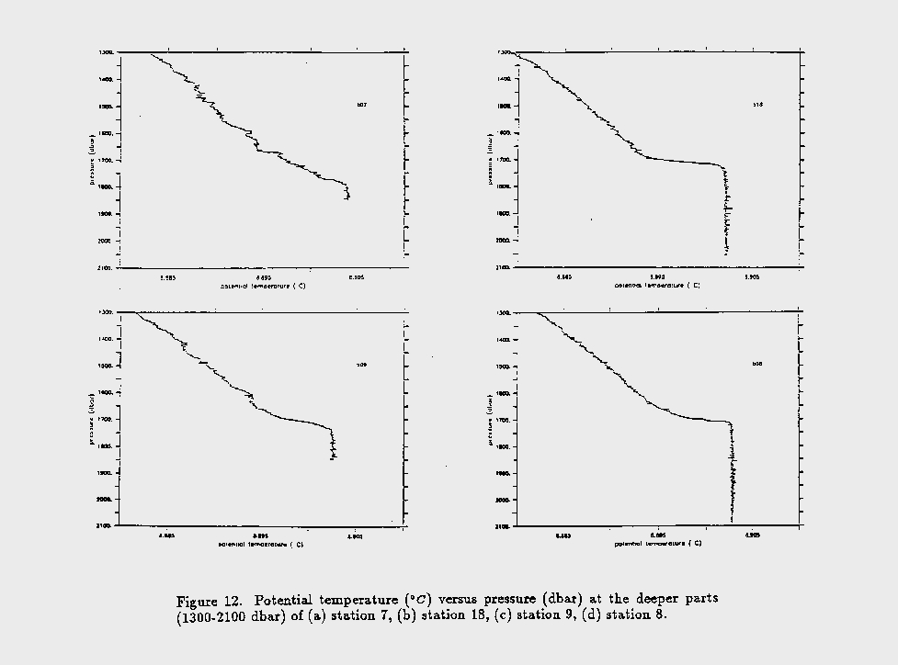
interface
Ri=600
Özsoy and Beşiktepe, 1994

Slide 36
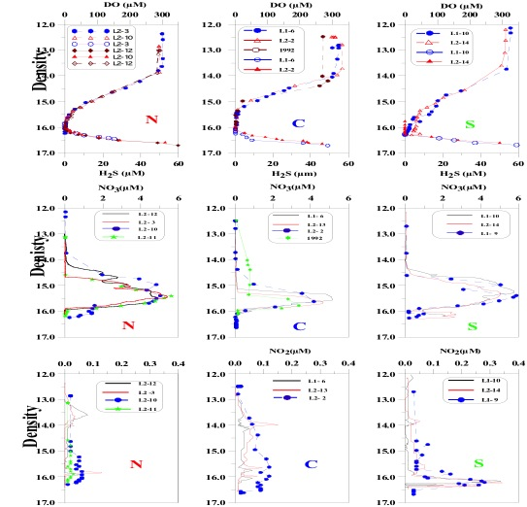
Suboxic zone is larger in the central basin O₂ penetrates at greater depths in SW coastal zone Similar features at similar density surfaces Secondary nitrate peaks due to lateral introsions Apparent nitrite peaks in the anoxic intrface zone

Slide 37
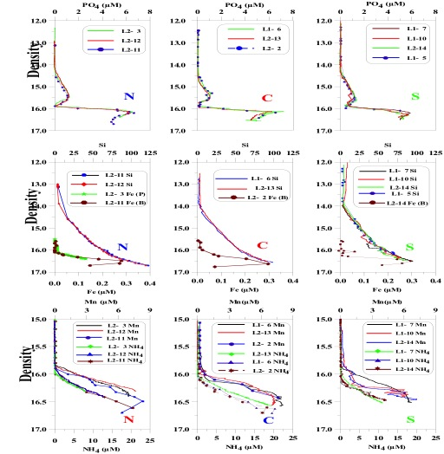
May-June 2001 Cruise: Similar verical features at similar density surfaces in the suboxic- anoxic transition zone Thick PO₄ minimum in the central B. Ondulating vertical features in the transition zone of SW coastal zone

Slide 38
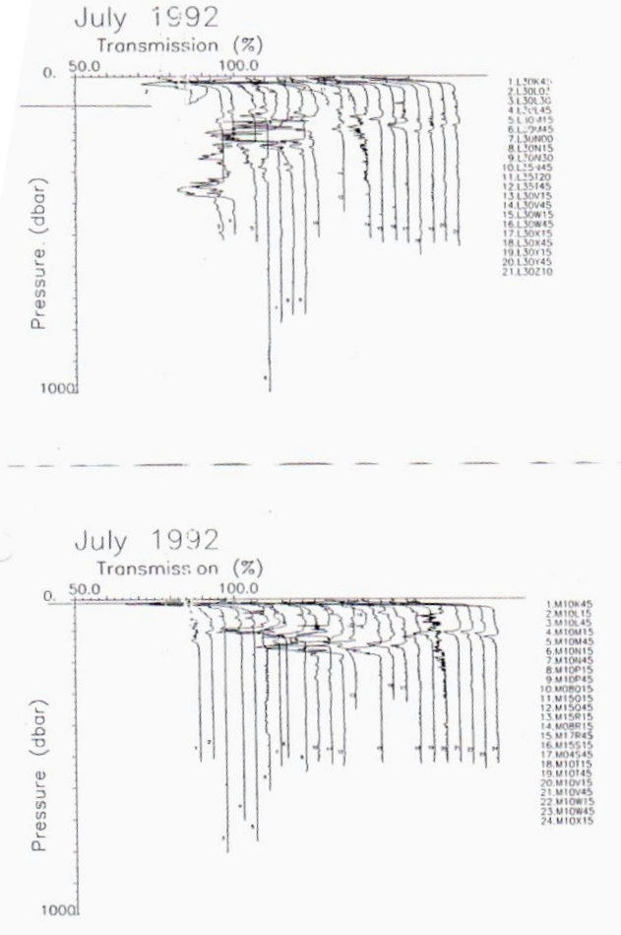
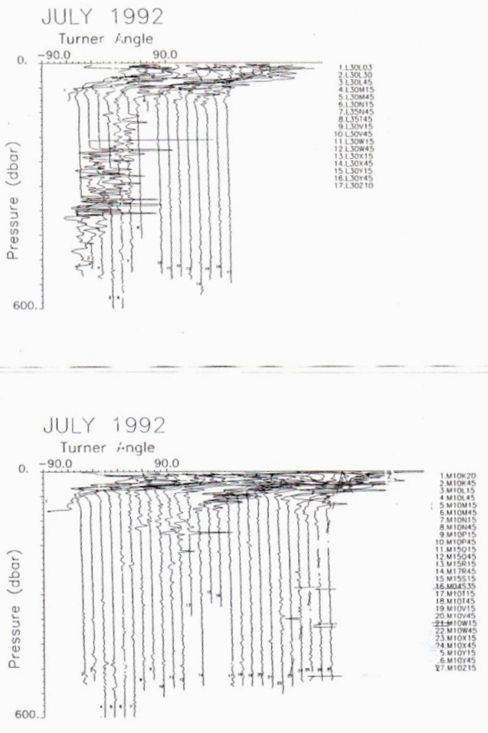

Slide 40
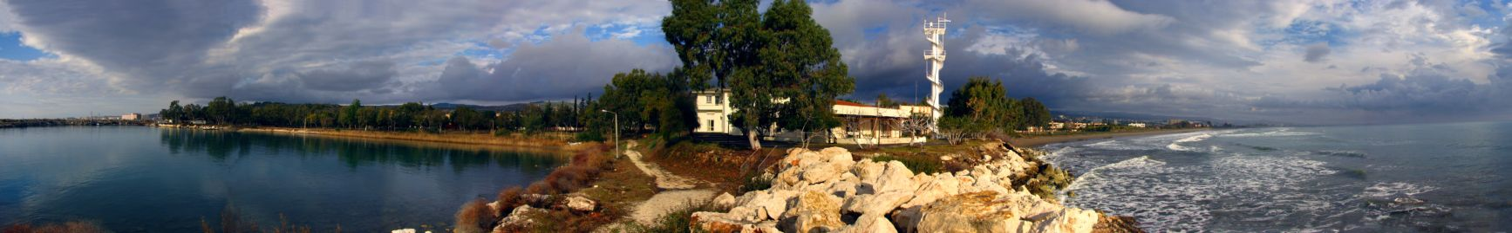


Turkish Straits System and Southern Black Sea: Exchange. Mixing and Shelf / Canyon Interactions
Emin Özsoy, Özgür Gürses, Ersin Tutsak
Institute of Marine Sciences,
Middle East Technical University
Erdemli, Mersin, Turkey

Slide 41
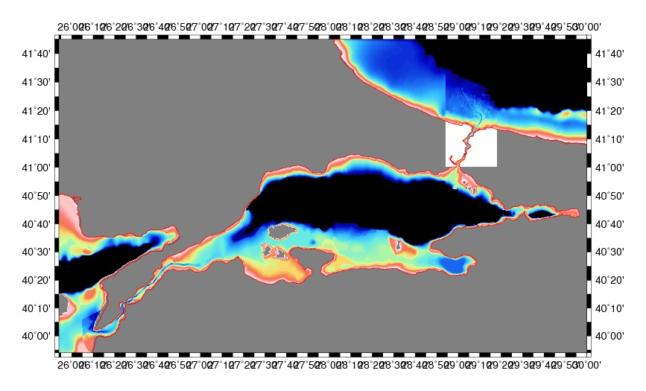
Turkish Straita Sytem
Aegean Sea -Dardanelles Strait – Marmara Sea – Bosphorus Strait – Black Sea

Slide 42
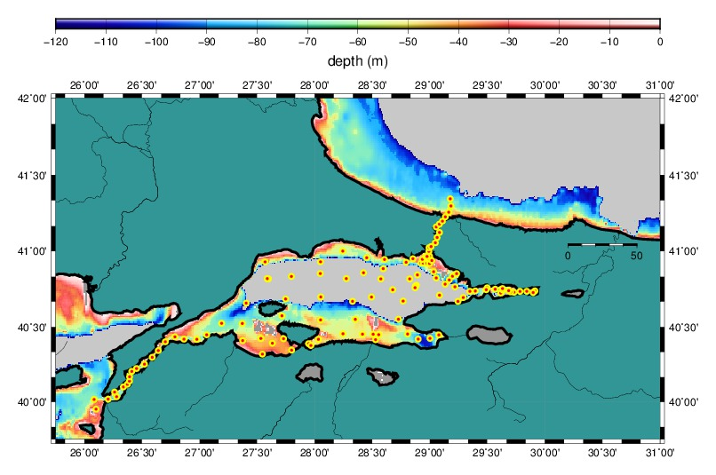
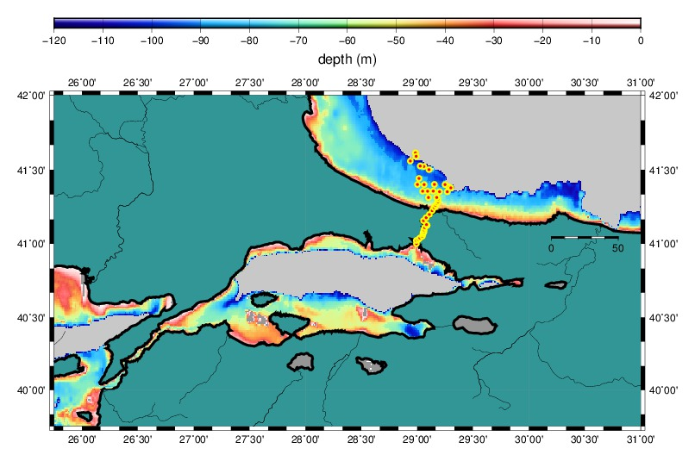
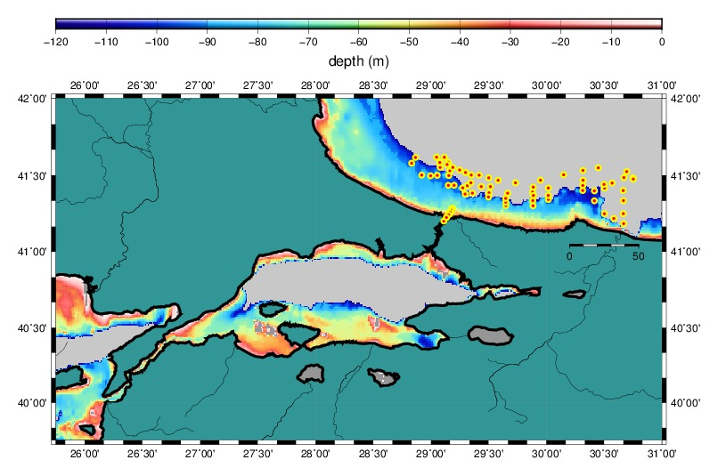
June – July 2013 experiment
R/V BİLİM
TSS 18-23 JUNE 2013
TSS 28-29 JUNE 2013
TSS 02-05 JULY 2013

Slide 43
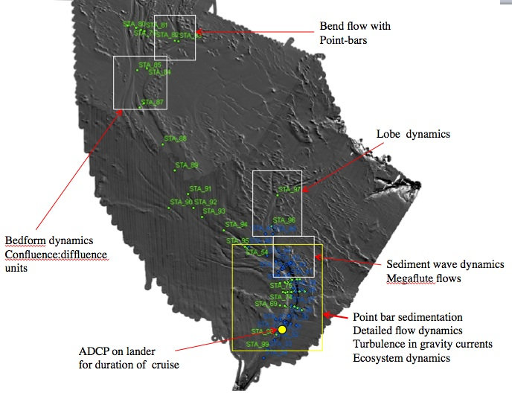
R/V Pelagia
Cruise
Jun-Jul 2013
Jeff Peakall
Dan Parsons
U. Leeds + ….

Slide 44
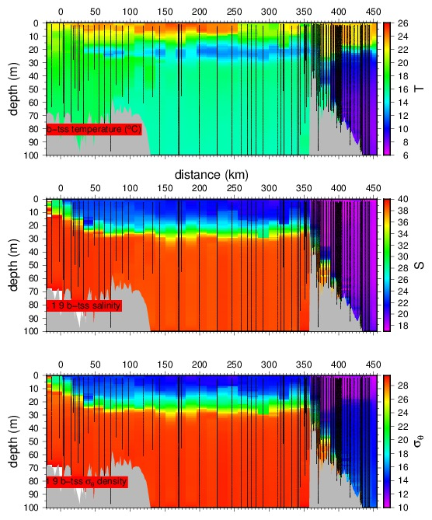
CIW
BSW
MW
Section across
Turkish Straits System

Slide 45
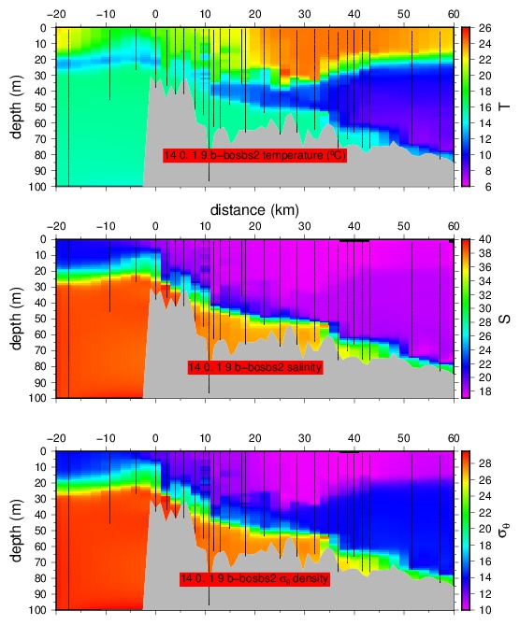
Bosphorus Strait

Slide 46
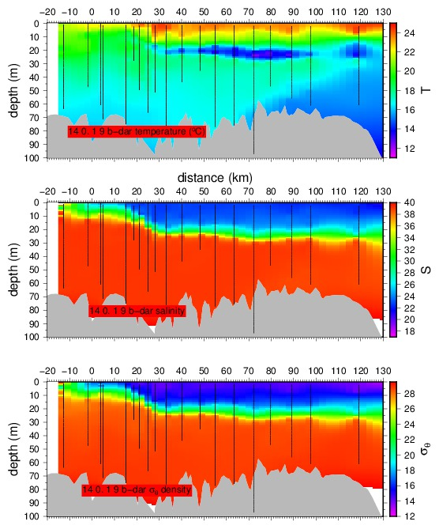
Dardanelles Strait

Slide 47

Black Sea exit region
And the SW Black Sea
shelf

Slide 48
Black Sea exit region
aka
“pre-Bosphorus channel”

Slide 51


Slide 52





Slide 54



Slide 55



Slide 58


Slide 59


Slide 60


Slide 62


Slide 63


Slide 64



Dense MW outflow

Slide 65



FPL: Mn, Fe
fine particulate layer
Dense MW outflow

Slide 66




Slide 67




Slide 68
Modeling of Black Sea Circulation and Mixing
Emin Özsoy (1,2), Robinson Hordoir (3), Nathalie Toque (1),
Hazem Nagy (1,4), Adil Sözer (1,5)
(1) Institute of Marine Sciences, METU, Erdemli, Mersin, Turkey
(2) İTÜ-AYBE, İstanbul, Turkey
(3) SMHI, Norrköping, Sweden
(4) Alexandria U., Alexandria, Egypt
(5) ODU-FIMS, Fatsa, Ordu, Turkey

Slide 69
IMS-METU Early BLACK SEA FORECAST MODEL – POM
(Hazem Nagy, Emin Özsoy)
Bathymetry was extracted from Gebco 2008 which has an horizontal resolution
in x and y is 0.5 minute (1/120°x1/120°) for the Black and Azov Seas.
Model grid:
horizontal resolution of 2.5 km in both x and y directions with 20 sigma layers
Initial conditions 3D – in 2009: Medatlas, in 2013: July 1992 complete coverage of the Black Sea
outflow of the rivers parameterized by salt flux boundary conditions
8 rivers of the Black and Azov seas implemented
The rivers are Danube, Dnieper, Dniester, Rioni, Kızılırmak, Sakarya, Don and Kuban.
Monthly average rivers discharge from Global River Discharge Database, Version 1.1
(Riv.Dis.v10 supplement at http://www.rivdis.sr.unh.edu).
Surface atmospheric data 1 hr, 0.05º horizontal-resolution, University of Athens IASA
The surface fluxes computed from Monin-Obukhov atmospheric boundary layer model
interactively using the atmospheric variables and sea surface temperature and salinity
developed in the ocean model.
The Bosphorus Channel was described in the model as 5 grid points in width (12.5 km)
and about 17 grid points in length (42.5 km) with maximum depth of 60 m. At the southern
open boundary, we impose for the normal velocity of 0.1 m/s that corresponds to net flux out,
and relax T,S profiles to adjust inflow-outflow.

Slide 70

IMS-METU
Black Sea forecasts, POM, 2009, 2011

Slide 71


The Black Sea POM, IMS-METU
(Hazem Nagy, Emin Özsoy)
(A)
(B)
Temporal evolution of POM Temperature profile in [°C]
Observation data of July 1992 as model initial conditions (black line)
and model averaged profile of one year simulation (Red line)
(B) time series of the Model profiles every 6 months over the whole simulation period.

Slide 72


The Black Sea POM, IMS-METU
(Hazem Nagy, Emin Özsoy)
The results on CIL temperature – compare 130716 vs 140205

Slide 73


(A)
The Black Sea POM, IMS-METU
(Hazem Nagy, Emin Özsoy)
(B)

Slide 74
Problems with POM and ROMS
Both POM and ROMS have been configured in the same way as the
2nd version of NEMO configuration, using the same bathymetry,
same horizontal grid and vertical discretization levels at the region
of maximum depth, surface and boundary forcings etc., but
the following problems with both models could not be overcome:
The results look good on the surface in both models,
but POM cannot preserve the CIL for more than few months
while ROMS preserves it longer but CIL is still excessively mixed.
We think the problem has to do with the sigma or s-coordinates
(terrain-following) in both models which introduce excessive errors in
horizontal and vertical mixing, resulting in fast erosion of the CIL layer.

Slide 75
The Black Sea 1st NEMO configuration, IMS-METU
(Nathalie Toque, Emin Özsoy)
NEMO 3.3.1
Model of the Black sea with the Azov sea
Domain: N40.55-N47.2, E26.34-42.22
Horizontal resolution: 1/12 degree (Δx6.5km, Δy=9.3 km) Z coordinate, partial steps, vertical resolution: 42 levels Dynamical time step: 270s, number of barotropic time steps: 50, time step: 5.4s
Bathymetry: GEBCO, max. depth 2250m
Surface atmospheric forcing: ECMWF ERA Interim, 3hr temporal resolution
clio bulk formulation Runoff: Danube, Dniestr, Dniepr and Don
Constant geothermal flux at the bottom (40.10⁻³ W/m2)
Open boundary condition: Vertical profiles of temperature and salinity
at 1 point located at the northern sill of the strait of the Bosphorus Initial conditions: Levitus temperature and salinity files.
Lateral diffusion: Laplacian for the tracer (rn_aht_0 = 100. m2/s)
Bilaplacian for the momentum (rn_ahm_0_blp = -7.10⁹ m4/s)
Generic Length Scale model (gls), Double Diffusion Mixing model (ddm)
List of the keys: key_mpp_mpi, key_ldfslp, key_dynspg_ts, key_trabbl, key_trabbc,
key_bdy, key_zdfgls, key_zdfddm

Slide 76




First results – Nathalie Toque – Emin Özsoy

Slide 77
The Black Sea 2nd NEMO configuration, IMS-METU (DIFFERENCES FROM 1st IN RED!)
(Robinson Hordoir, Adil Sözer, Hazem Nagy, Emin Özsoy)
NEMO 3.4
Model of the Black sea with the Azov sea
Domain: 40.92°-47.30°N, 27.43°-42.00°E
Horizontal resolution Δx=2.5km Z coordinate, partial steps, vertical resolution: 60 levels
(adjusted to topography and density variations) Dynamical time step:
240s, number of barotropic time steps: 100, time step: 2.4s (for large K_{h}, A_{h} =400 m²/s)
240s, number of barotropic time steps: 600, time step: 0.4s (for small K_{h}, A_{h} = 10 m²/s)
Bathymetry: GEBCO 2008, max. depth in model grid 2201m
Surface atmospheric forcing: U. Athens - IASA Skiron, 0.05º horizontal-resolution
1hr temporal resolution - core bulk formulation Runoff: Danube, Dniestr, Dniepr, Don, Kuban + Turkish rivers (total 12 rivers)
No geothermal flux at the bottom
Open boundary condition: Vertical profiles of temperature and salinity and η=0
at 1 point wide strait of the Bosphorus Initial conditions: July 1992 temperature and salinity objectively analyzed data set
Laplacian lateral diffusion for the tracer (rn_aht_0 = runs with 400 and 10 m²/s)
Laplacian lateral mixing for the momentum (rn_ahm_0 = runs with 400 and 10 m²/s)
Generic Length Scale model (gls), No Double Diffusion Mixing model – yet!
List of the keys: key_mpp_mpi, key_ldfslp, key_dynspg_ts, key_trabbl, key_lim3, key_iomput,
key_bdy, key_zdfgls, key_nosignedzero, key_BSEA_LIM3

Slide 78

model
vertical
levels

Slide 79


initial conditions:
CoMSBlack July 1992
S, surface
S at 89 m depth

Slide 80

model bathymetry

Slide 81

monthly river fluxes

Slide 82

great variability in interannual river fluxes !

Slide 83


February and September barotropic currents, temperature

Slide 84


February and September surface currents, temperature

Slide 85
Satellite SST
on 12 Sep 2012
MHI model SST
12 Sep 2012
NEMOBlack
hindcast SST
on 12 Sep 2012

Slide 86





Slide 87





Slide 88
More satisfactory results on CIL
With NEMOBlack model

Slide 89

Surdface mixed layer
Cold Intermediate Water
CIW

Slide 90


Slide 91
Thank you !

